Slide 1

AIspire Studio – Inspiring Brands, Instantly
AI-powered branding solutions for startups and small businesses seeking fast, affordable, and professional results

Slide 2
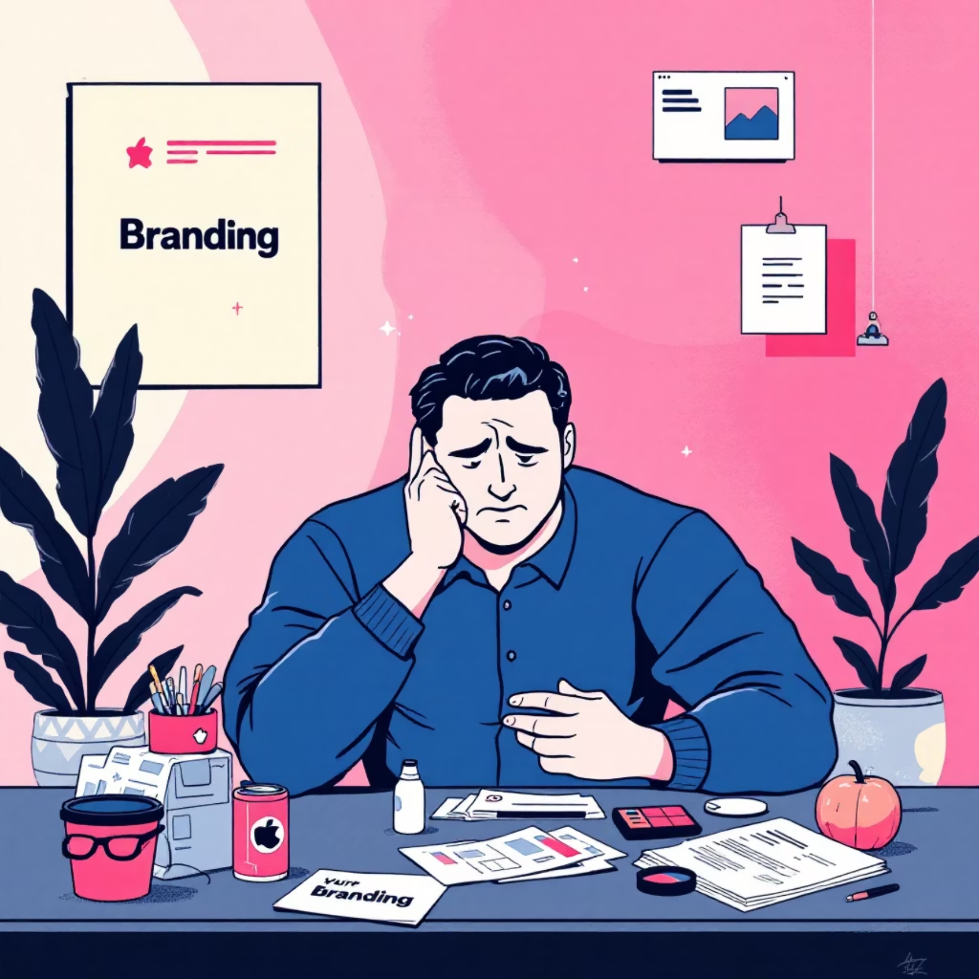
The Branding Challenge for Startups
Building a memorable brand is one of the most critical steps for any startup, yet it's often where founders face their biggest obstacles.
Traditional branding agencies charge premium prices and require weeks or months to deliver, making them inaccessible for businesses operating on lean budgets and tight timelines.
Slow Turnaround
High Costs
Inconsistent Vision
Traditional agencies take weeks or months to deliver branding assets
Premium pricing puts professional branding out of reach for most startups
Final designs often fail to capture the founder's original vision and brand identity

Slide 3

AIspire Studio's Solution
We've revolutionized the branding process by combining cutting-edge AI technology with design expertise to deliver professional-quality branding materials in minutes, not months.
01
02
Share Your Vision
AI Creates Magic
Tell us about your brand, values, and aesthetic preferences through our simple intake process
Our advanced AI algorithms generate multiple professional design options tailored to your needs
03
Refine & Launch
Select your favorites, request adjustments, and receive final files ready to use immediately

Slide 4
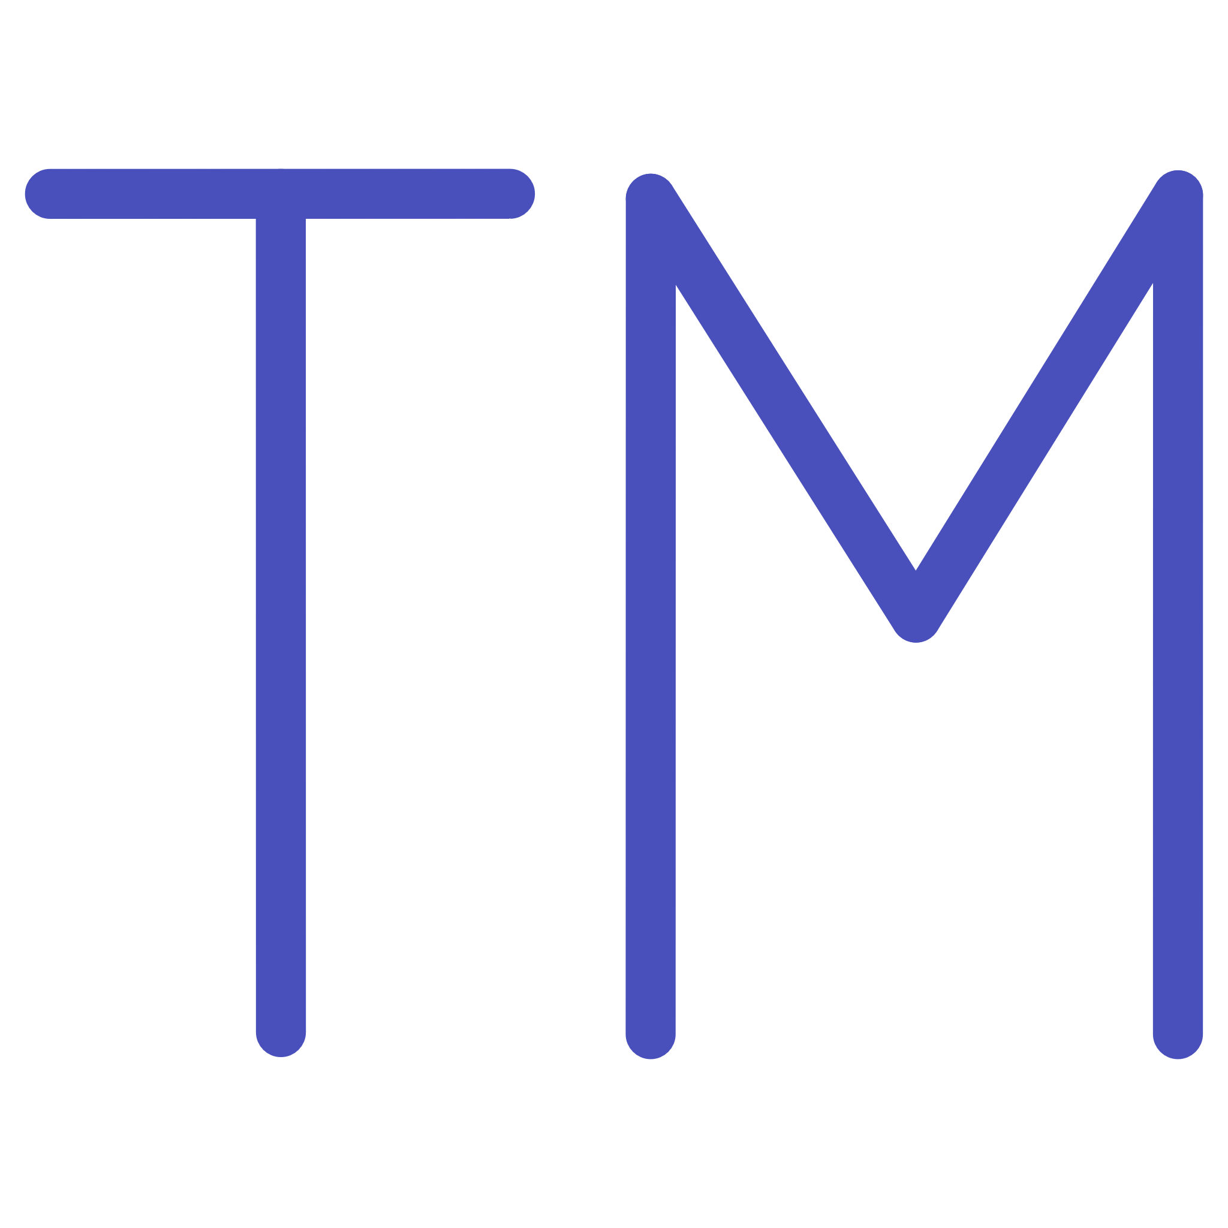


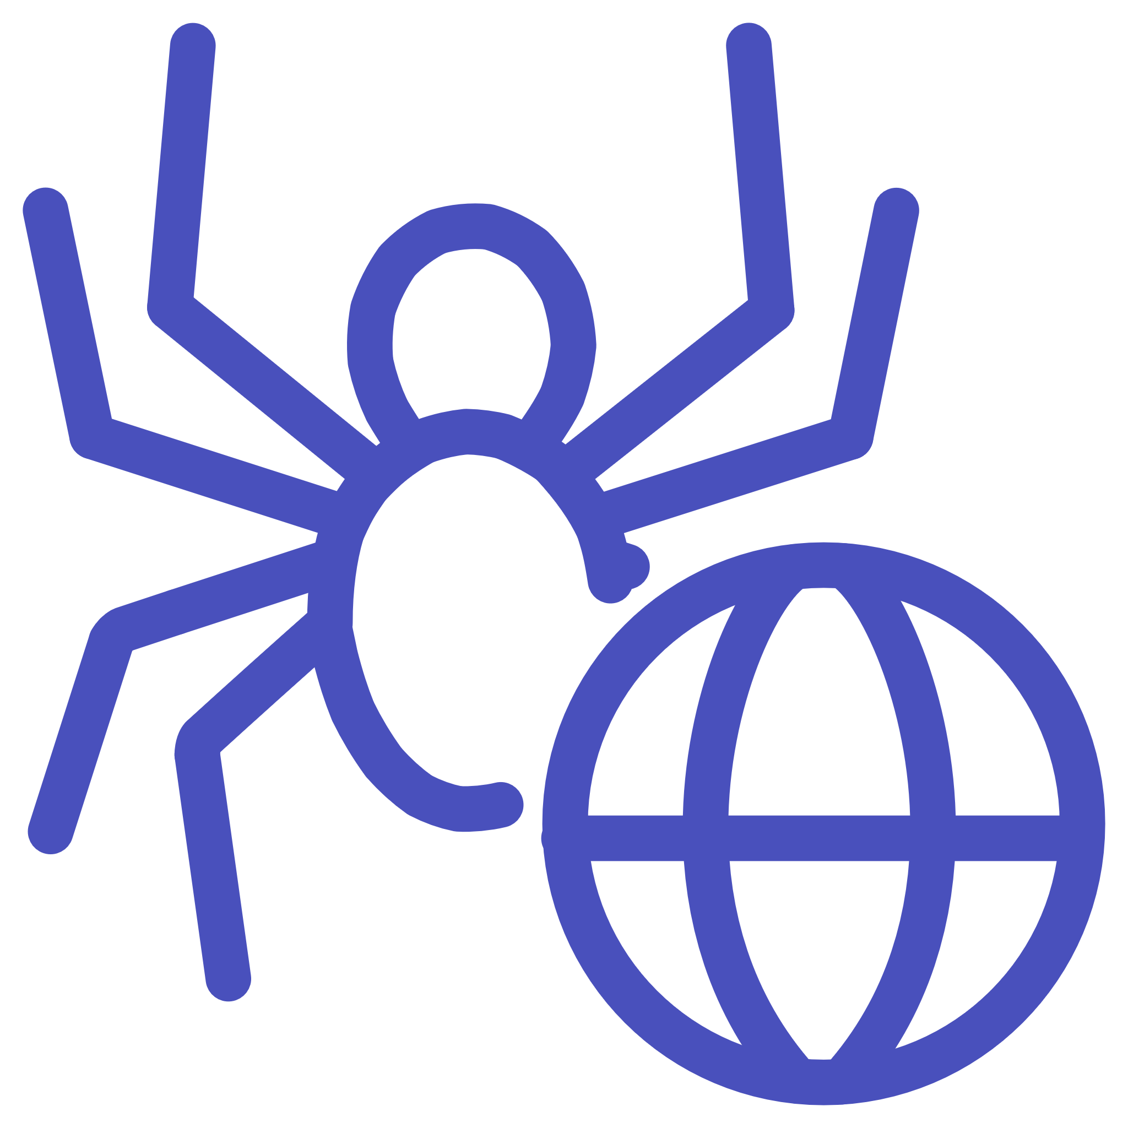
Our Services
Everything your startup needs to build a cohesive, professional brand presence across all channels
AI-Generated Logos
Social Media Graphics
Unique, memorable logos that capture your brand essence with unlimited variations and formats
Eye-catching posts, stories, and cover images optimized for every major platform
Marketing Copy & Content
Website Mockups
Compelling blog posts, website copy, and promotional materials that convert
Professional landing page designs and full website layouts ready for development

Slide 5
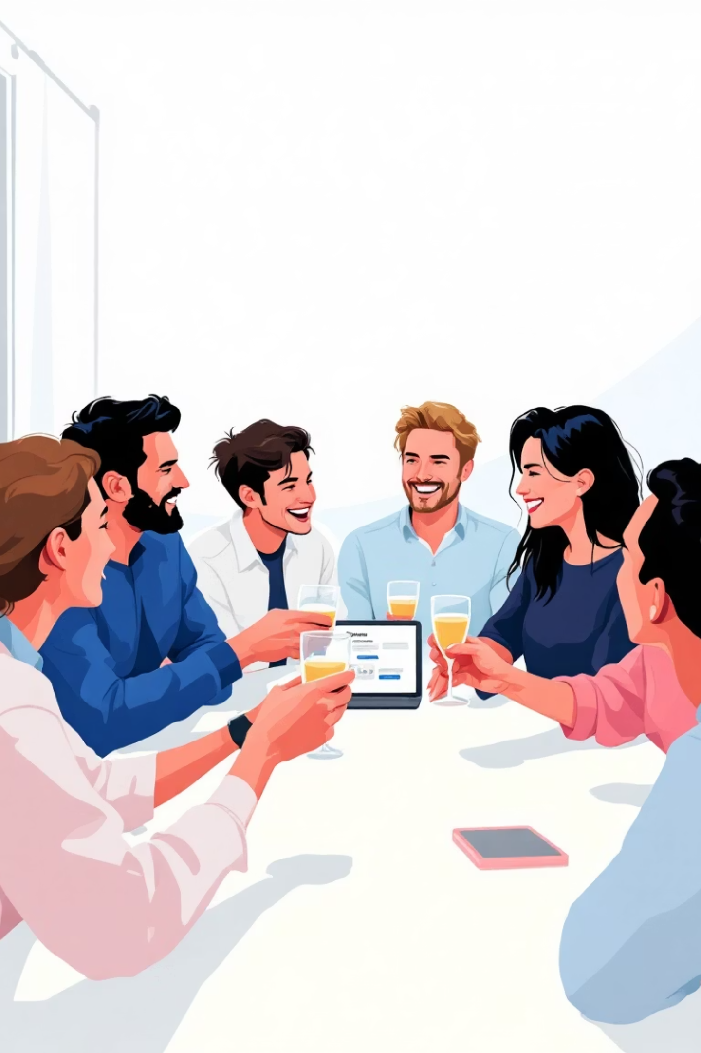




Why Choose AIspire Studio?
Lightning-Fast Turnaround
Receive your complete branding package in minutes instead of waiting weeks or months for traditional agencies
Startup-Friendly Pricing
Professional branding at a fraction of traditional agency costs, making premium design accessible to every budget
Professional Quality
AI-powered designs that rival human designers, with consistent quality and unlimited revisions
Stand Out From Competition
Leverage cutting-edge AI creativity to build a distinctive brand that captures attention and drives growth

Slide 6
Our Impact in Numbers
Real results from startups and small businesses that transformed their brands with AIspire Studio
500+
15min
90%
4.9/5
Brands Created
Average Delivery Time
Cost Savings
Client Satisfaction
Startups and small businesses launched with professional branding
Compared to traditional branding agencies
Average rating from our satisfied customers
From brief to final branding assets ready to use

Slide 7
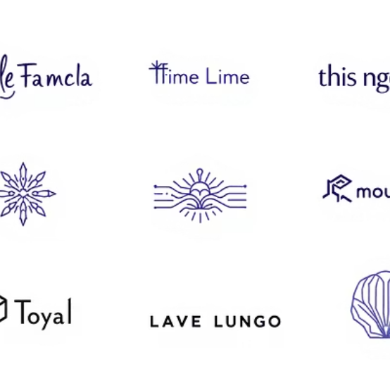
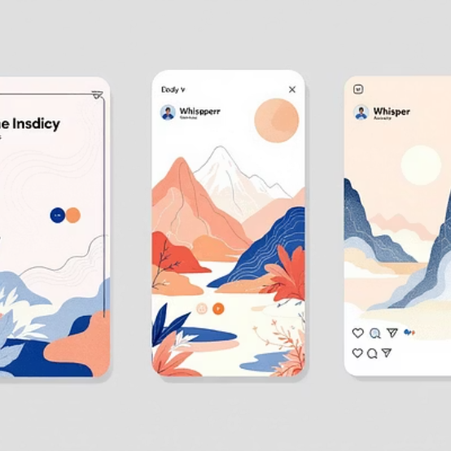
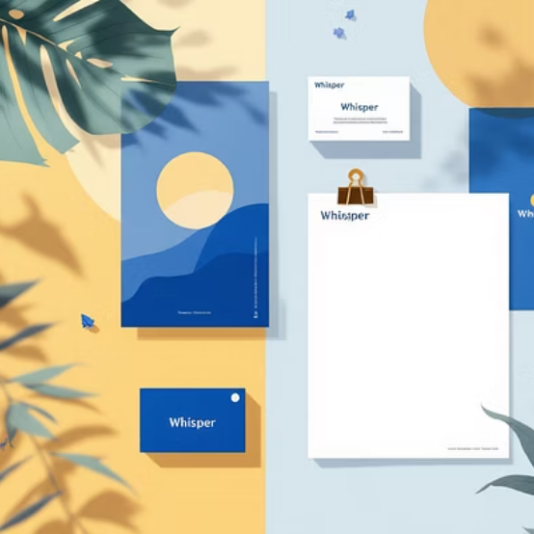
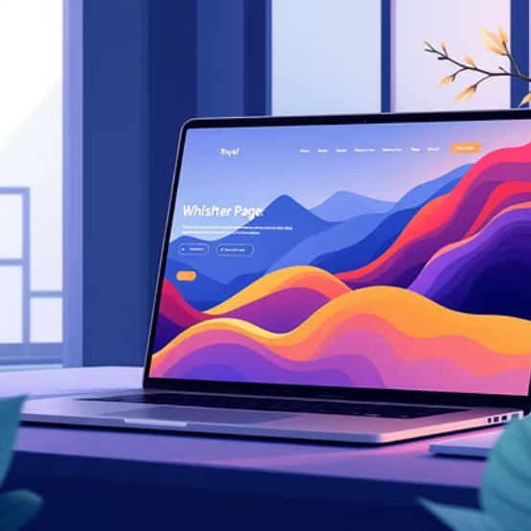
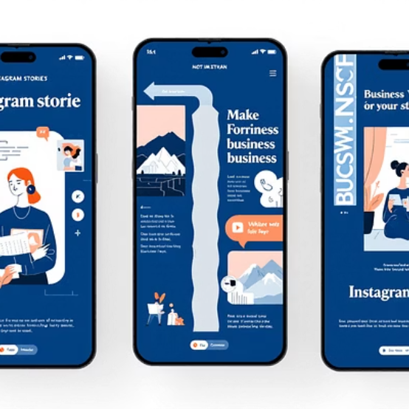
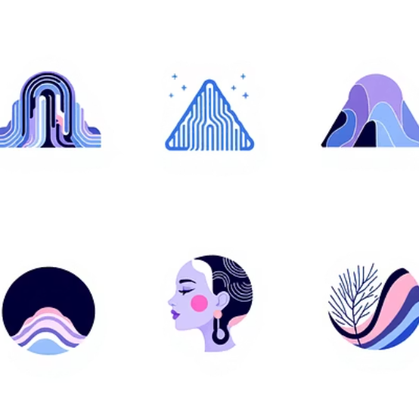
Our Work Speaks for Itself
Explore a selection of AI-generated branding materials that showcase the creativity, professionalism, and versatility of our platform
Each design is crafted to reflect unique brand personalities while maintaining professional standards that drive business growth and customer engagement.

Slide 8
Simple, Transparent Pricing
Starter
Professional
Enterprise
$199
$499
$999
Perfect for launching your brand
Complete branding solution
Everything you need to scale
3 logo concepts
5 logo concepts
Unlimited logo concepts
Basic brand colors
Full brand guideline
Complete brand package
2 social media templates
10 social media templates
30+ marketing assets
1 revision round
Website mockup
Website design
Unlimited revisions
Priority support

Slide 9
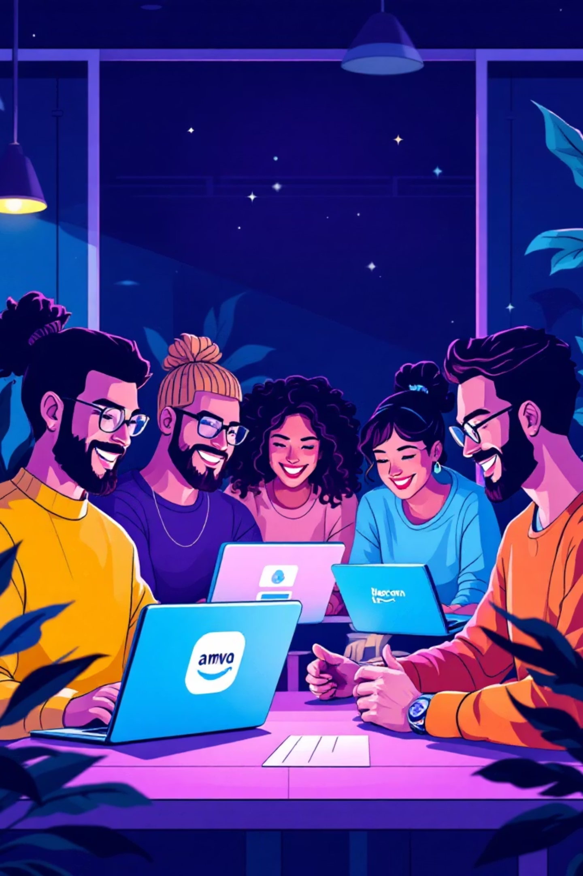
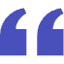
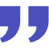
What Our Clients Say
"AIspire Studio gave us a professional brand in under an hour. What would have cost us $5,000 and taken months, we got for a fraction of the price. Absolutely game-changing for our startup."
"The quality is incredible. I was skeptical about AI design at first, but the logos and graphics look like they came from a top agency. Plus, the speed is unbeatable."
— Marcus Johnson, CEO of GreenLeaf Co.
— Sarah Chen, Founder of TechFlow
"Finally, professional branding that fits a startup budget. AIspire Studio understood our vision perfectly and delivered assets we're proud to use everywhere."
— Priya Patel, Co-founder of CloudNest

Slide 10
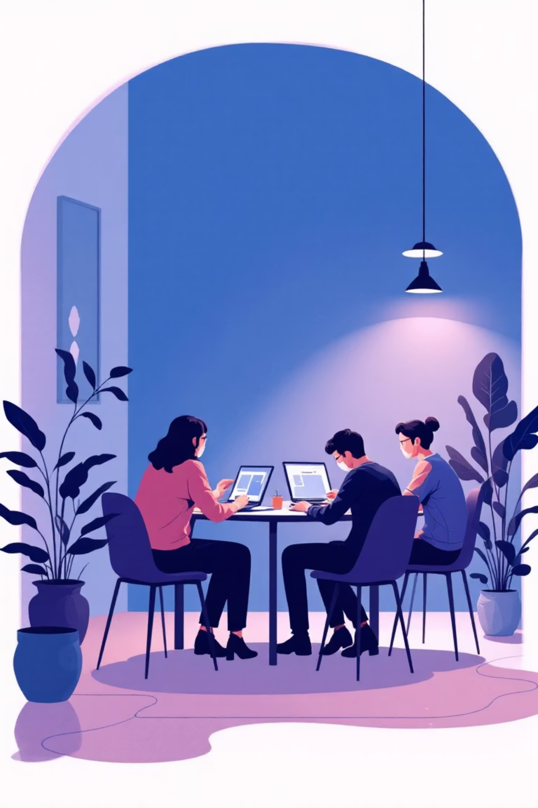





Let's Build Your Brand Together!
Book your AI branding session today and elevate your startup's presence with professional designs that inspire confidence and drive growth.
Email Us
Visit Our Website
hello@aispire.studio
www.aispire.studio
Follow Us
@aispire.studio

